Slide 1
Security Architecture and Engineering
Sonika Verma
CSCD92: Week 06

Slide 2
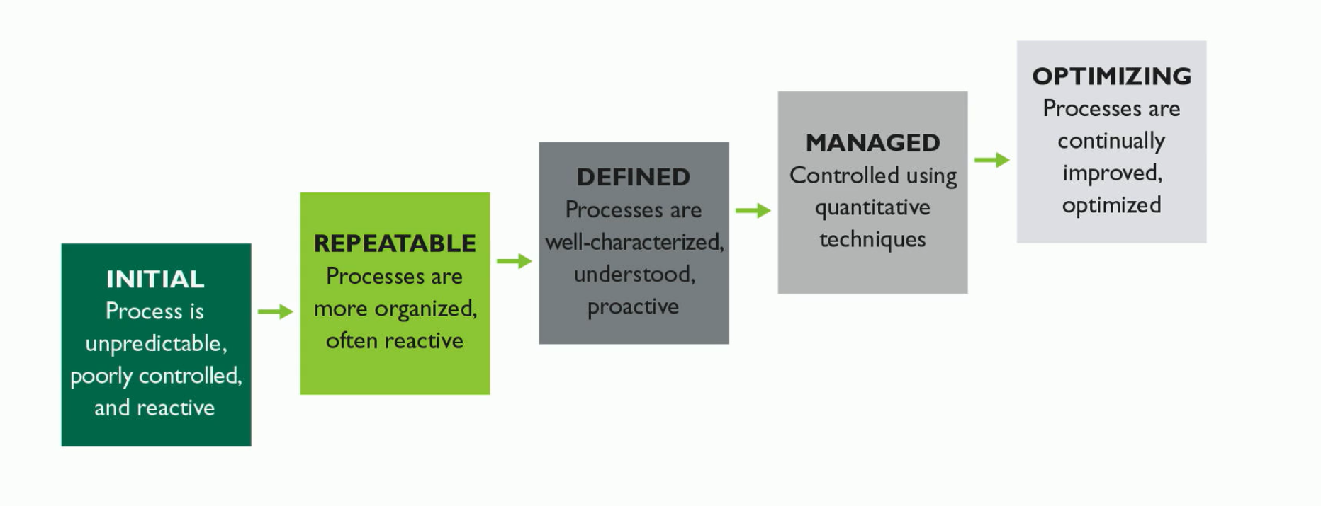
Security Architecture, Design, and Solutions
Security engineering
System Security Engineering Capability Model

Slide 3
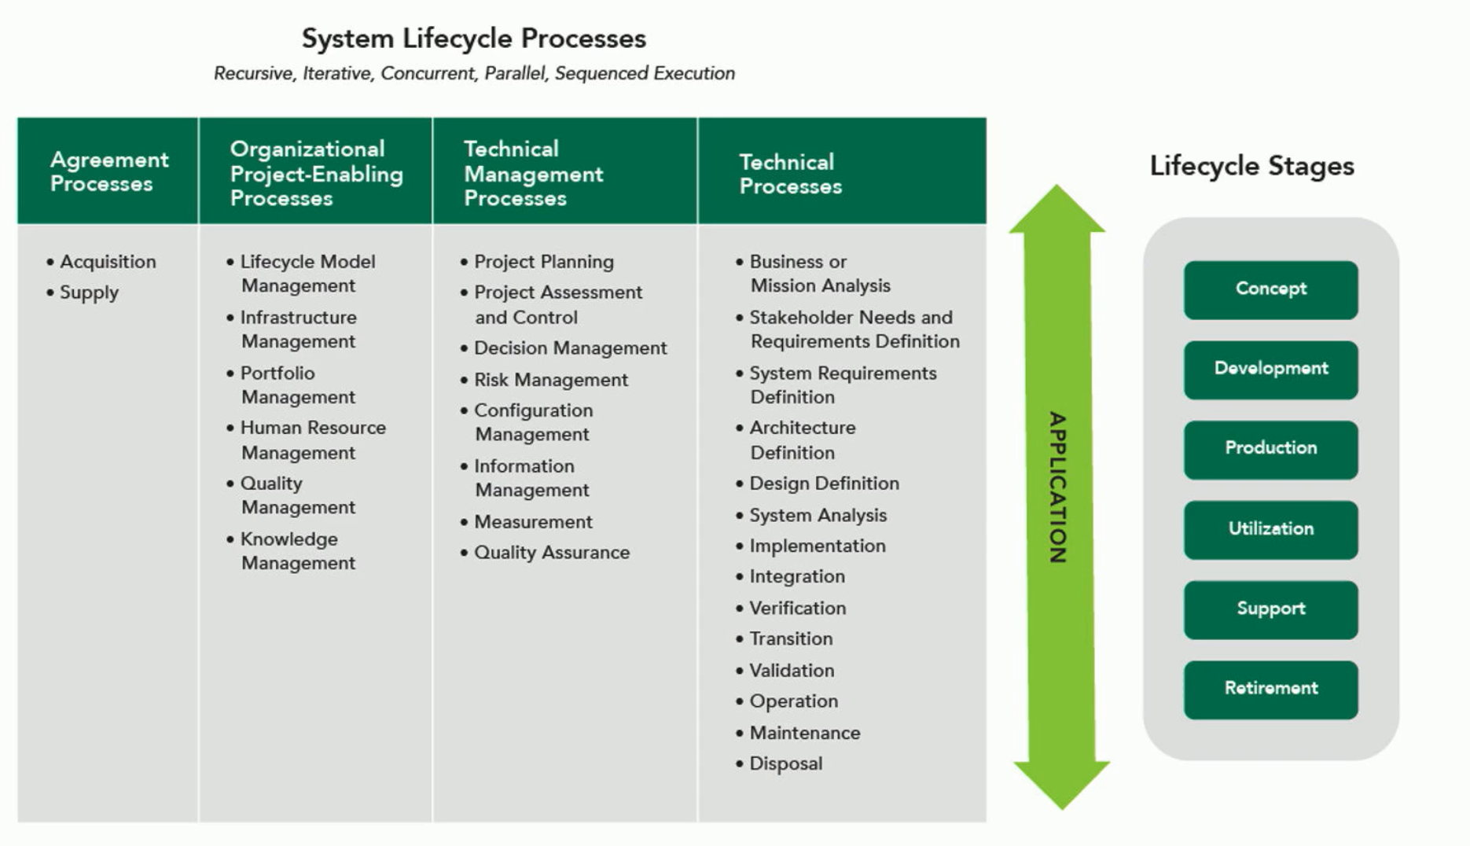
System Lifecycle Processes

Slide 4
Security Models
Security architecture
State machine model
Information flow model
Non-interference model
Ring model
Trusted platform model

Slide 5
Securing Memory Management
Memory isolation
Process isolation
Naming distinctions
Virtual mapping
Encapsulation of processes
Limit access of shared resources
Abstraction
Virtualization & Sandboxes

Slide 6
Host-Based Protections
Antivirus software
Host-based intrusion prevention system
Host firewall
File integrity monitoring
Configuration and policy monitor

Slide 7
Assessments, Vulnerabilities, and Mitigations
Client-based systems
Server-based systems
Database systems
Industrial control systems
Distributed control, programmable logic control
Embedded systems (+ IoT)
Distributed systems
Virtualized systems
Interference
Aggregation
Data mining
High-value targets

Slide 8
Cloud Computing
On-demand self-service
Broad-network access
Resource pooling
Rapid elasticity
Measured service
Multi-tenancy
Private cloud
Community cloud
Public cloud
Hybrid cloud
Government cloud

Slide 9
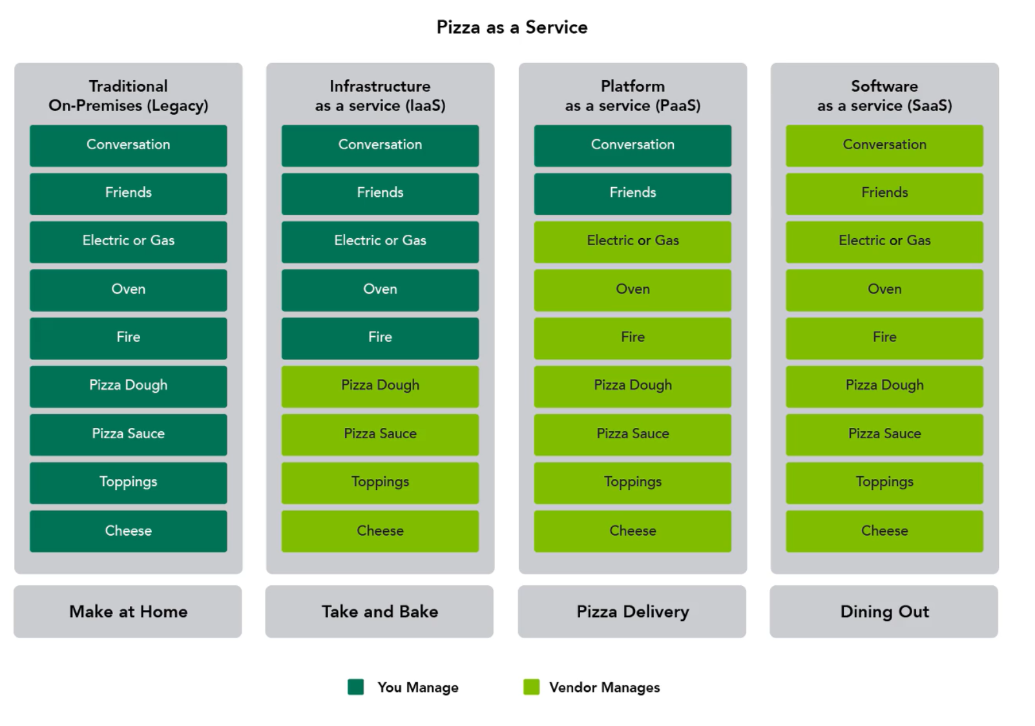
Cloud Computing
[SaaS] software as a service
[PaaS] platform as a service
[IaaS] infrastructure as a service
[CaaS] communication as a service
[CompaaS] compute as a service
[DsaaS] data storage as a service
[NaaS] network as a service

Slide 10
Assessments, Vulnerabilities, and Mitigations
Microservices
Containers
VM Sprawl
Serverless systems
High-performance computing systems
Edge / Fog computing

